Slide 1
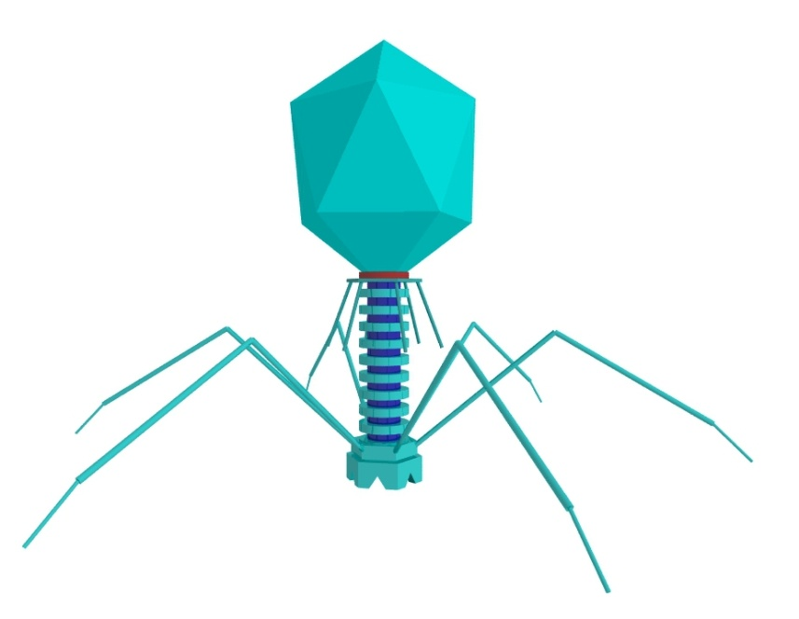
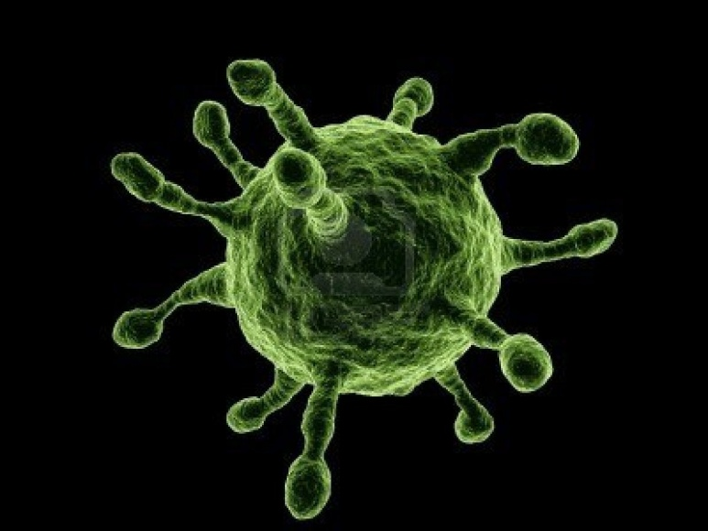
Virus
Are Viruses living organisms?

Slide 2
Virus Definition
Non-cellular, lifeless particle
Why?
Cannot make its own energy
Cannot reproduce on its own (must invade another living cell)
Not classified in any of the kingdoms
There are 165 groups of viruses

Slide 3
Virus Description
Virus are made up of 2 parts
Genetic material – may be either DNA, or RNA
Capsid – protective protein coating
Viruses range in size from 10 – 400 nm
Foot and mouth (10), influenza (115)
Bacteria? (.4 to several micrometers)
Human Cell? (6-8 micrometers

Slide 4
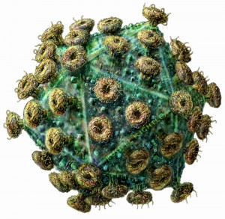
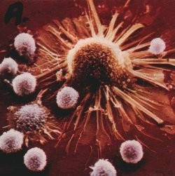
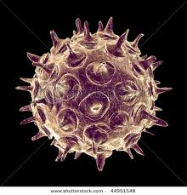
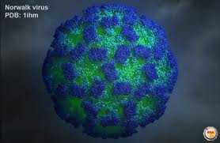
Cold Virus
AIDS
Norwalk
Chicken pox

Slide 5
Viral Replication
Textbook page 105
Record and draw the 4 steps used by viruses to reproduce
What is the name given to this cycle
How long does it take the cycle to complete?
Describe the lysogenic (lysogeny) cycle and how it is different.
Read page 106-107 and summarize the role of antibiotics and vaccines (define and summarize how they are developed and used).

Slide 6
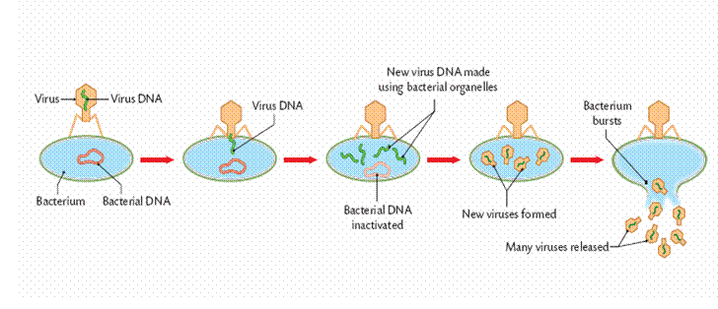
Lytic Cycle

Slide 7
Beneficial Viruses?
Building high-tech materials
Fighting disease such as cancer
One group called the bacteriophages, attack bacteria and they have been studied to assist in our understanding of viruses
Vaccines
Genetic treatments

