Slide 1
Safety at ODSS

Slide 2
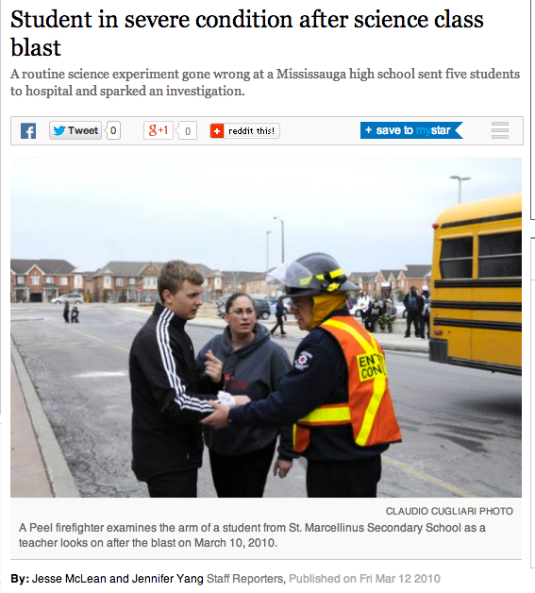
Science Safety Training
If you use your common sense, most accidents can be avoided
Unfortunately, there have been recent accidents in schools
Students of the UGDSB are now required to know/be able to demonstrate safety skills before participating in lab activities.
You will need to complete and pass, with 70%, the written safety tests.

Slide 3
1. Student Responsibilities

Slide 4
1. Student Responsibilities
Students must follow all lab safety rules as outlined in the student safety agreement.
Failure to do so may result in injuries to oneself and classmates
Consequences for repeatedly not following safety rules may include removal from class during lab activities.

Slide 5
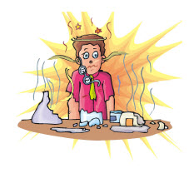
1. Student Responsibilities
Students are responsible for proper use and handling of lab equipment
Includes cleaning and putting away
If equipment is lost, damaged for broken, a replacement fee is charged.

Slide 6
2. Student Safety Agreement
Actually read the rules!!! You are responsible for knowing them
Ask me if you have any questions
HOMEWORK (what on the first day??) Get your parents to sign and return TOMORROW!
No form, No labs!

Slide 7
2. Safety Agreement
The following is a selection of some of the rules you will agree to by signing the safety agreement.

Slide 8
Read Lab procedures before beginning

Slide 9
Use proper safety Equipment

Slide 10
Never eat or drink anything in the lab or science classroom

Slide 11
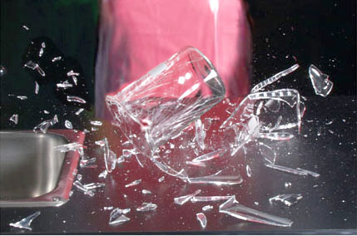
5. Never use broken equipment

Slide 12
6. Use only science containers during labs

Slide 13
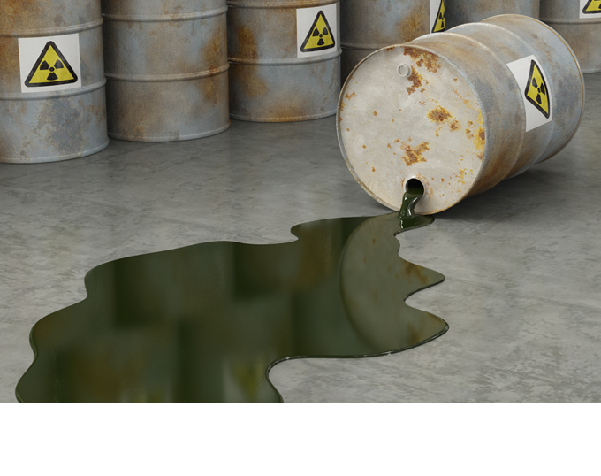
7. Report all chemical spills to your teacher

Slide 14
Report any accident or injury to your teacher, no matter how small

Slide 15
Know the location and use of all safety devices

Slide 16
If your clothing catches on fire, smother it with the fire blanket. “Stop, Drop, and Roll” NEVER RUN

Slide 17
11. Tie back long hair and loose clothing

Slide 18
Dispose of chemicals and other substances properly

Slide 19
Never run or be silly during a lab experiment!

Slide 20
3. WHMIS 1988
Older WHMIS symbols and system used. All new products use a new system, but since we are still using some older products students must still learn the old system of symbols.
Stand for:
Workplace Hazardous Materials Information System
Review the WHMIS SYMBOLS

Slide 21
1. Compressed Gas

Slide 22
2. Flammable

Slide 23
3. Oxidizing Materials

Slide 24
4. Poisonous

Slide 25
5. Toxic

Slide 26
6. Biohazard

Slide 27
7. Corrosive

Slide 28
8. Dangerously Reactive

Slide 29
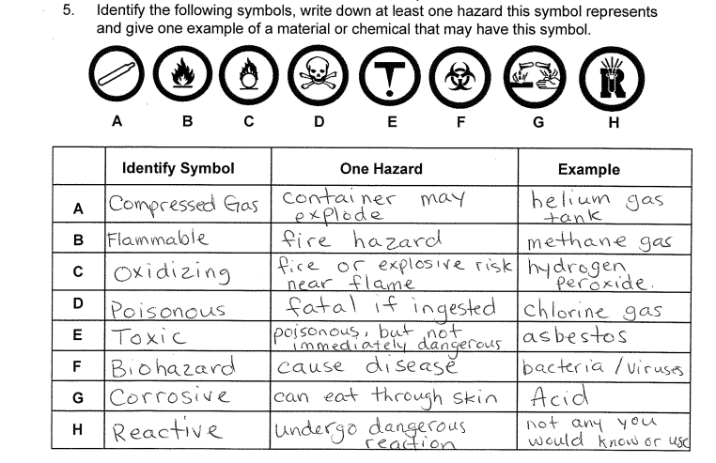

Slide 30
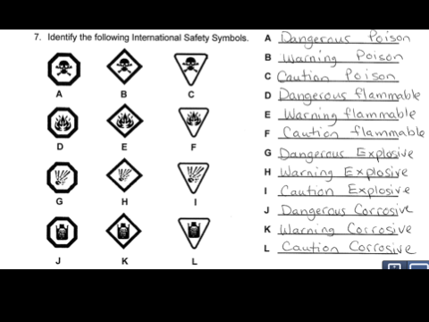
HHPS (household product symbols
items not protected under whmis but still pose hazard use the following symbols. The border tells the degree of hazard

Slide 31
WHMIS 2015
WHMIS got an update in 2015 and is based on an international system of warning symbols.
Review the symbols.
You will need to know all of these symbols for the test.

Slide 32
Explosive or Reactive

Slide 33
Oxidizing hazards

Slide 34
Corrosive

Slide 35
Serious Health Effects

Slide 36
Fire Hazard

Slide 37
Compressed Gas

Slide 38
Poisonous

Slide 39
Less Serious Health Effects

Slide 40
Biohazard

Slide 41
4. Emergency Devices and PPE
Locate in the classroom the following emergency devices or PPE
PPE = personal protective equipment
Fire Extinguisher
Fire Blanket
Closest Fire Alarm pull station
Fire alarm exit
First aid kit
Safety Goggles
Eyewash station
Broken glass Container
Disposal container for chemicals
Intercom or closest telephone

Slide 42
5. Emergency Procedures
Make sure you know
Where to go during a fire alarm, lockdown, tornado
How to use the safety equipment
Immediately report injuries
Immediately report damaged equipment

Slide 43
6. Personal Protective Equipment (PPE)
Must wear closed-toe shoes
Long hair needs to be tied back
All items from elbow down removed
Rings, watches, etc
Must wear PPE as appropriate for the activity
Use heat resistant gloves or tongs to handle equipment or materials that are hot

Slide 44
7. Handling Glassware Training
Never handle broken glass
Check glassware prior to use for chips, cracks or damage
Do not use damaged or dirty glassware
Allow hot glassware to cool prior to washing or adding substances to prevent cracking
Wash all glassware after use with soap and water

Slide 45
8. Electrical Safety Training
Inspect for damaged wires, missing prongs, broken connections or wet plugs before using
Always switch off power before plugging or unplugging
Unplug cords by holding and pulling on the plug, not the cord
Do NOT tie power cords in notes
Never use damaged equipment
Do not mix electrical equipment with water
Failure to do the above may cause electrocution, shock, or fire.

Slide 46
9. Using a Bunsen Burner
Students stand when using a bunsen burner
Should be lit with a flint lighter, never a match or lighter
Do not leave unattended
Adjust to have a blue flame when in use
Students are not to reach across an open flame

Slide 47
9. Bunsen Burner
Placed at least 30 cm from any flammable or combustible substance including wooden cabinets/shelves and edge of lab surface
No substance is to be put into and open flame unless directed by the teacher
Must be allowed to cool prior to being put away

Slide 48
10. Laser Pointer (grade 10)
All lasers pose significant potential for eye injury if misused
To use them safely follow these rules
Never look directly into the laser beam
Do not point laser at any person
Never aim at reflective surfaces expect as directed by your teacher

