Slide 1
Prokaryotic Micro-organisms
Bacteria and Archaea

Slide 2
Characteristics
All prokaryotes are single-celled organisms.
Prokaryotes have a rigid cell wall for protection
DNA is in the shape of a loop
Bacteria reproduce asexually through binary fission (splitting in two)
Most abundant organisms on earth
10ml of soil can contain 1x10¹⁰ bacteria
Bacteria found in the deepest oceans and the highest levels of the atmosphere

Slide 3
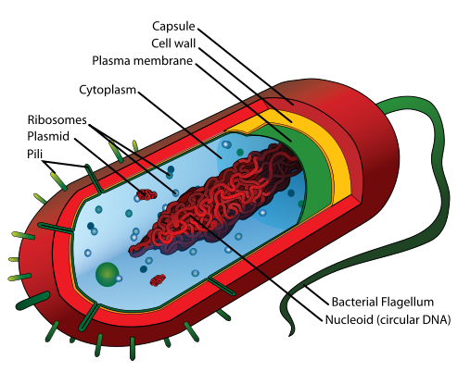
Common Structures

Slide 4
Pili – short hair-like extensions, these are used to attach to other cells
Flagellum – used to aid movement. Rotates like a propellor
Plasmid – small piece of DNA within cytoplasm
There is no membrane around “nucleoid”

Slide 5
Kingdom Archaea
Oldest group of organisms.
Live in inhospitable environments.
Made up of 3 groups:
Halophiles – live in very salty environments like the Dead Sea.
Methanogens – live in oxygen free environments like swamps and sewage plants.
Thermoacidophiles – live in extremely hot and acidic environments like volcanoes.
Ex. Some species live in temperatures over 100 degrees Celsius

Slide 6
Bacteria
More successful than Archaea.
Live in many different environments.
Include both beneficial and disease causing (pathogens) types.

Slide 7
Identification and Classification of Bacteria
Bacteria can be classified based on 3 characteristics
Shape
a) Cocci (round) – singular coccus
Monococcus
Diplococcus
Streptococcus
Staphylococcus
Ex. Streptoccus mutans – responsible for tooth decay

Slide 8
Identification and Classification of Bacteria
b) Bacilli (rod shaped) – singular bacillus
Single
Pair
Chains
Ex. Clostridium botulinum – responsible for botulism/food poisoning

Slide 9
Identification and Classification of Bacteria
c)Spirilli (spiral shaped)
– singular spirillum
Ex. Treponema pallidum – responsible for syphilis
Structure of cell wall
Sources of food and energy

Slide 10
Now What?
Microviewers – set up chart
Complete 5 for Harmful Bacteria and look at Slides 1,2,3,7,8 for Helpful Bacteria
With notes and text (page 194-195) answer questions #5-6, #1-4 on page 199.
Disease Name | Shape | Diagram | Interesting Fact (from booklet)

