Slide 1
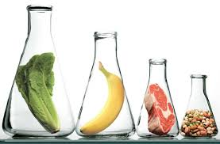
Nutrients
The macromolecules needed for fuel.
The Killer American Diet

Slide 2
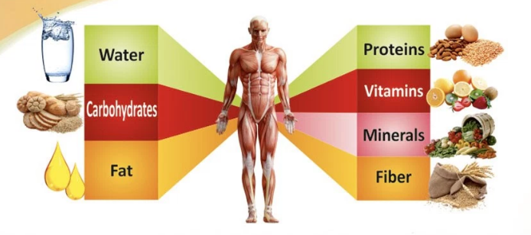
Nutrients
What is a nutrient?
What do you need to eat to survive?
Fats
Proteins
Carbohydrates
Vitamins
Minerals

Slide 3
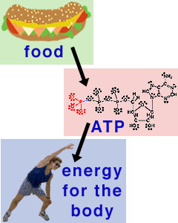
Nutrients
Raw materials needed for cell metabolism
(metabolism - basic cell functions)
3 major groups of biological importance:
Carbohydrates
Proteins
Lipids
Most are made up of large molecules containing carbon, hydrogen, oxygen, and nitrogen.
These are called macromolecules

Slide 4
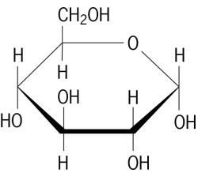
1. Carbohydrates
Structure
Molecules containing atoms of carbon, hydrogen and oxygen.
Chemical formula is a fixed proportion of these atoms in ratio of:
1 : 2 : 1
Carbon hydrogen oxygen
Ex. Glucose is C₆H₁₂O₆

Slide 5
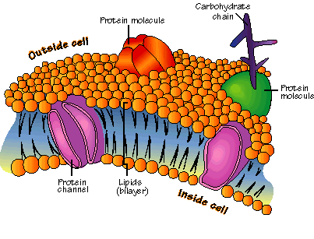
carbohydrates
Function
Represent the body’s most important source of energy and preferred source of long term and short term energy.
Acts as cell identification as part of the cell membrane

Slide 6
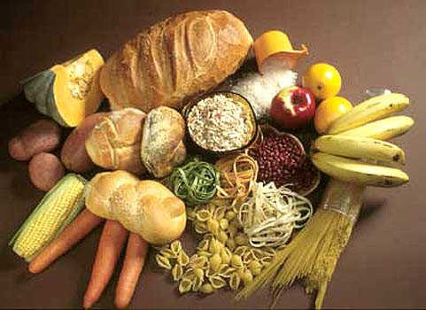
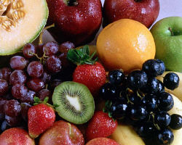
Carbohydrates
Types and Sources
Rely on plants to provide them.

Slide 7
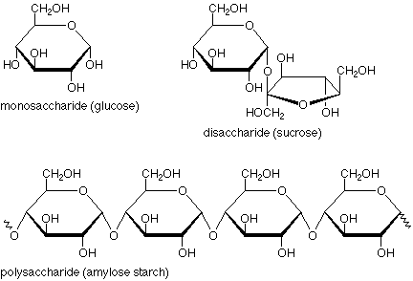
What do you notice?

Slide 8
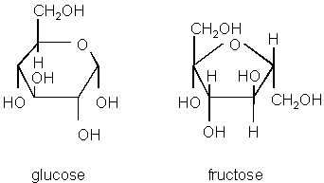
3 types of carbohydrates

Slide 9
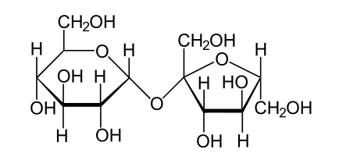
3 types of carbohydrates
Disaccharides
“di” means two
made up of two sugar molecule
ex. sucrose (table sugar) and lactose (dairy)

Slide 10
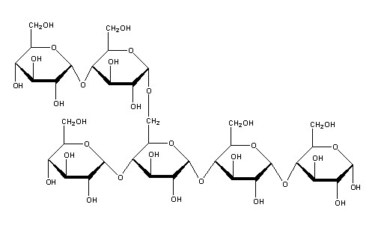
3 types of carbohydrates
Polysaccharides
“poly” means many
complex carbohydrate made up of many single sugars linked together
ex. Starch, cellulose, glycogen, chitin

Slide 11
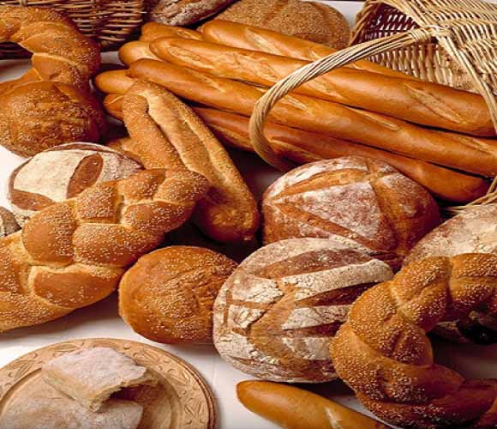
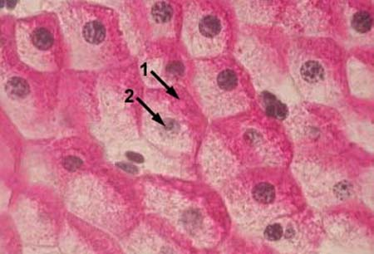
Carbohydrates in Our Body
Excess sugar (simple carbs) are stored as polysaccharides in the cell in 4 different forms
Starch – used by plants to store
excess energy (carbs)
Glycogen – used by animals to store excess energy in the cells (especially the muscles) and the liver

Slide 12
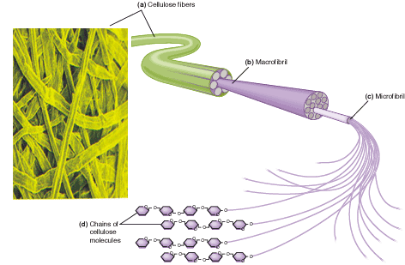
Carbohydrates in Our Body
Cellulose – used by plant cells to form the cell wall
Also known as “fibre” and cannot be digested by humans for energy but is useful in maintaining a healthy digestive tract
Is the major component of wood/paper/cotton

Slide 13
Chitin...not digestible
Chitin – forms a hard exterior for insects, lobsters, shrimp…
Is a modified form of cellulose
Very difficult to digest
Used in medical stitches, various industrial processes, specialized contact lenses!

Slide 14
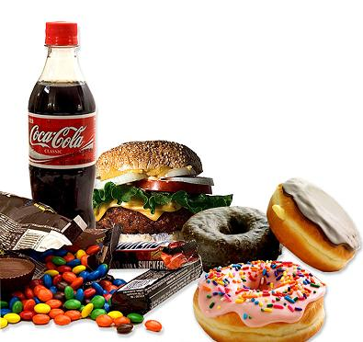
Carbohydrates in Our Body
When these polysaccharides stores are full, any excess carbohydrates are converted to fat as another source of long term energy
Jaime Oliver
Aspartame video

