Slide 1
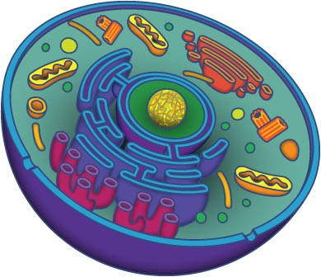
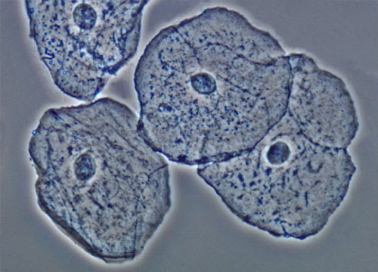
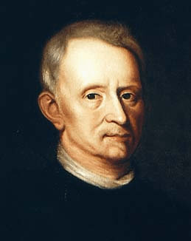
Cellular Biology

Slide 2
Recall…..
Biology is the study of life based on the cell theory
All living things are composed of one or more cells
The cell is the smallest unit that
retains the properties of life.
New cells arise only from cells that
already exist.
Robert Hooke
Discovered cells in 1655

Slide 3
Recall: A cell is the smallest unit of life that can carry on all life processes
What does that mean?
To maintain life cells (organims) must be able to:
Grow/reproduce
Repair
Obtain nutrients for energy
Remove waste
Respond to the surrounding environment
Maintain homeostasis!

Slide 4
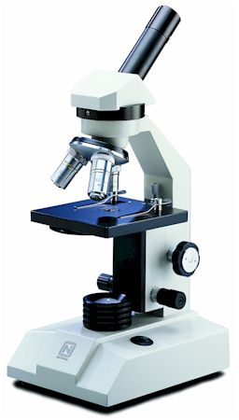
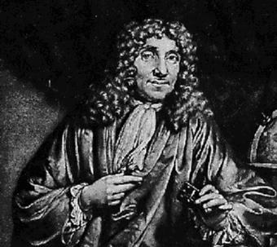
Microscopy

Slide 5
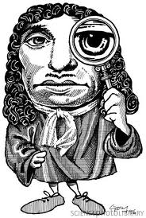
Microscopes
Developed by Antonie Philips van Leeuwenhoek
A Dutch tradesmen
considered the “Father of Microbiology” for his work developing the microscope
First to describe single celled organisms
Bacteria
Parasites
Sperm cells
Blood cells

Slide 6
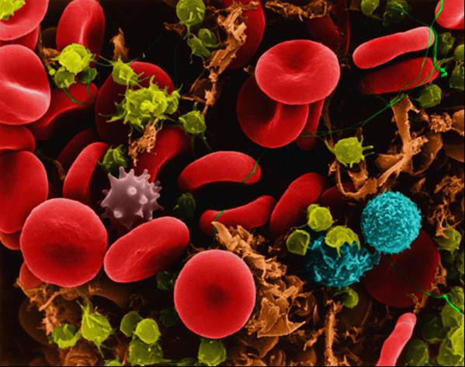
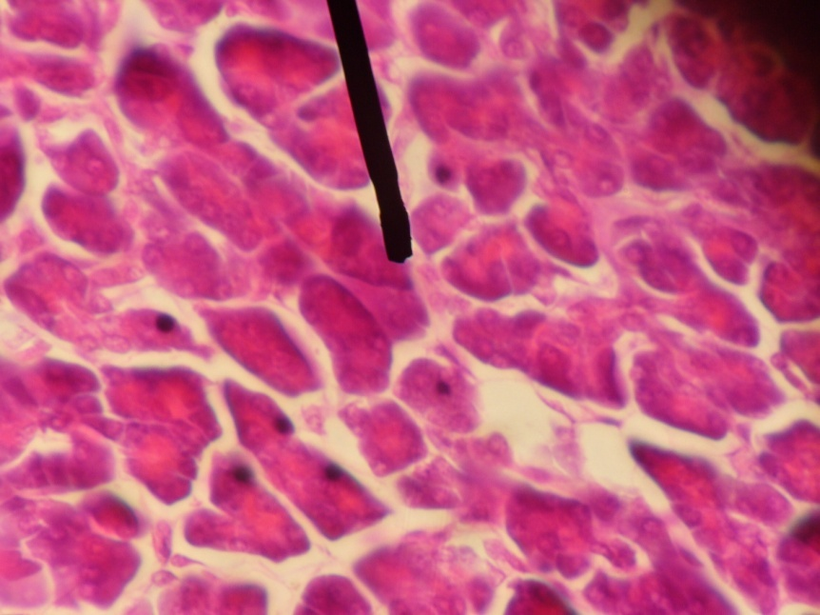
Cytology
Means the study of cells
Has driven and led to the advancements in microscope technology

Slide 7
Microscopes
Magnifying Power
Ability of a lens to enlarge the image
of a specimen
Depends on the power of each lens

Slide 8
Microscopes
Resolution
Refers to the amount of detail seen when viewing a specimen
Poor resolution produces blurry images
Good resolution produces sharp images in which features close together appear separate and distinct
Human eye has resolution of 0.1 mm. If 2 points are closer that that, the eye sees them as one.

Slide 9
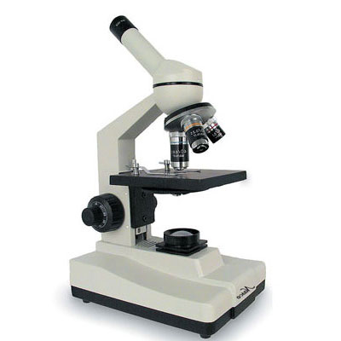
Types of Microscopes
1. Compound Light Microscope
Relies on light to generate the image
Uses several glass lenses in succession to focus light
Magnification is limited to about 2000x
Resolution is limited to about 0.2 micrometers (0.0000002m)
Disadvantage
Limited magnification and resolution
Advantage
Relatively inexpensive

Slide 10
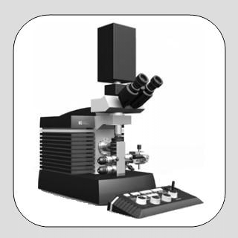
Types of Microscopes
2. Electron Microscopes
Relies on electrons to produce the image
Uses electromagnets to focus electron beam
Magnifies millions of times!
Resolution of 1 nanometer (0.000000001 m)!
Disadvantage
Expensive to purchase
No coloured images (no light used)
Cannot view live specimens (dead and dehydrated)
Specimens need to be extremely thin (0.02 um)
Advantage
High resolution and very high magnification

Slide 11
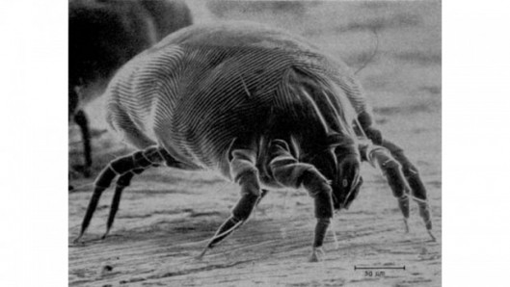
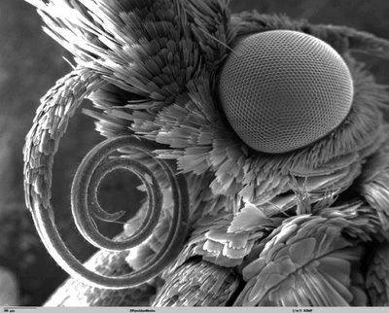
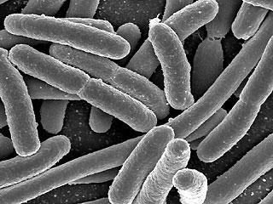
dust mite
Butterfly tongue
bacteria
cell

Slide 12
Types of Cells

Slide 13
Cell Features
Organelles – means “little organ”
- a unique structure that performs a specific function with the cell
Plant and Animal Cells have several basic organelles in common.
Nucleus
Cell Membrane
Cytoplasm

Slide 14
What now?
Draw and label plant and animal cells on page 52-53 of the textbook
Complete Cell Organelle Chart
Text page 51 #1 - 3
Cell Membrane | Cell Wall | Cytosol
Nucleus | Ribosomes | Endoplasmic Reticulum
Vesicles | Golgi Body | Vacuoles
Lysosomes | Mitochondria | Chloroplast
Cell wall

