Slide 1
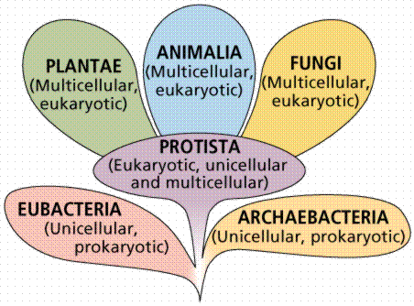
Kingdom Fungi

Slide 2
Eukaryotic cell
Have cell wells
Anchored in soil
Reproduction can be sexual or asexual
Stationary
Plant
Use photosynthesis
Starch is the main storage molecule
Most have roots
Cellulose in the cell wall
Some reproduce by seed
Fungi
Are heterotrophs
Have few or no storage molecules
Have no roots
Have Chitin in cell walls
None reproduce by seed

Slide 3
The Kingdom is classified into 4 main groups
Sac Fungi
Imperfect Fungi
Club Fungi
Zygospore Fungi

Slide 4
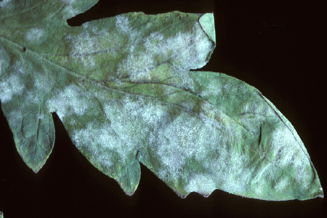
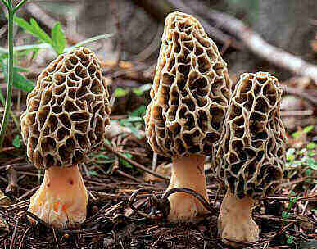
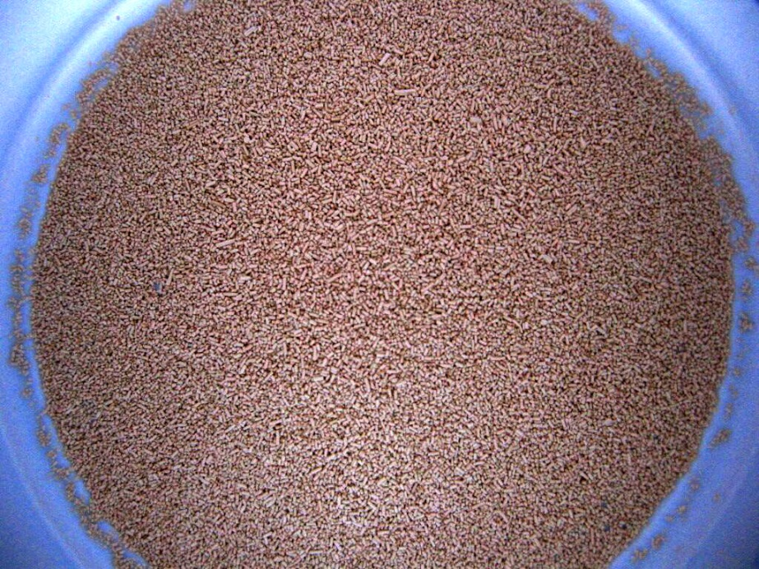
Sac Fungi
Largest group
Includes mildews, morels, and yeast

Slide 5
Imperfect Fungi
Only reproduce asexually
Are an important group for humans
Medical
Penicillin – is the antibiotic that comes from green mould
Cyclosporin – is a drug from a fungus that is used to suppress the immune system of organ transplant patients

Slide 6
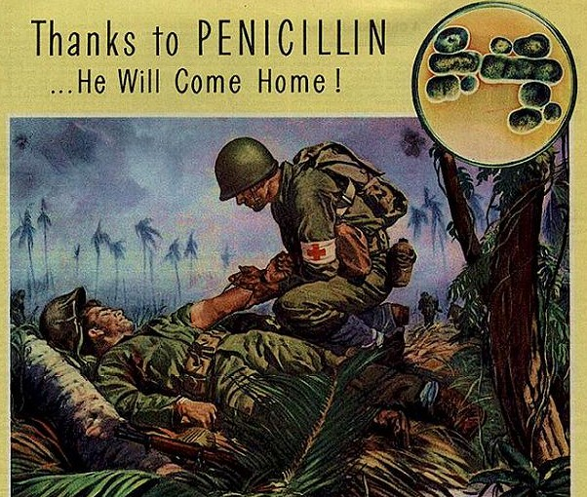
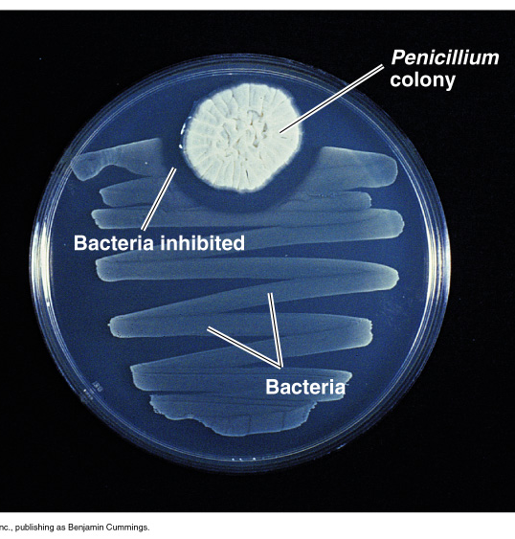

Slide 7
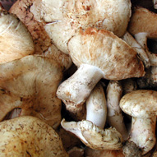
Imperfect Fungi
Food Industry – uses fungi to make soya sauce, blue cheese, and assorted types of edible mushrooms
Ex. - Matsutake Mushrooms – $1000/pound
The matsutake mushroom is expensive because of its rarity. While its historical prevalence meant it was nearly synonymous with autumn in Japan, the introduction of an insect that kills the trees under which the mushroom grows has caused a dramatic decrease in the number of matsutake mushrooms. A method for farming the matsutake has yet to be developed, which means the lack of trees from which to harvest these mushrooms naturally is a serious problem for the species.

Slide 8
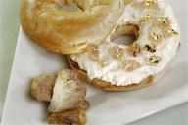
Ex. - The World’s Most Expensive Bagel – $1000
This bagel, created by Executive Chef Frank Tujague for New York’s Westin Hotel, is topped with white truffle cream cheese and goji berry infused Riesling jelly with golden leaves. The bagel’s price is justified when you consider that white truffles happen to be the second most expensive food by weight, eclipsed only by caviar. The underground fungus grows only under specific oak trees in Alba, Italy. Their pheromone-like odor is considered to be an aphrodisiac and is the reason dogs and female pigs are used to hunt the precious truffle.

Slide 9
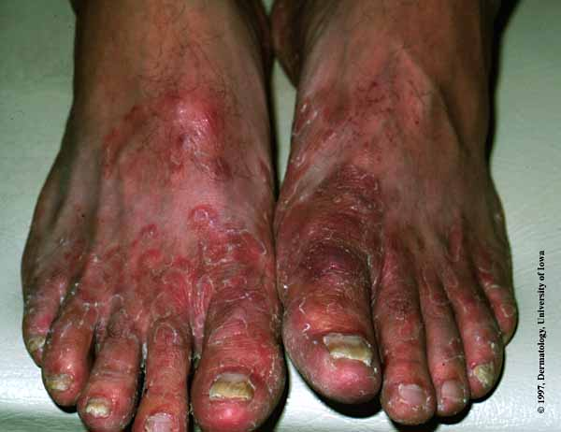
Imperfect Fungi
Disease – causing fungi include athletes foot and yeast infections, and a variety of other conditions

Slide 10
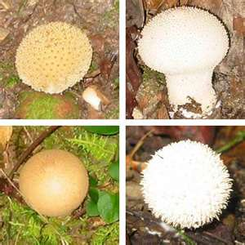
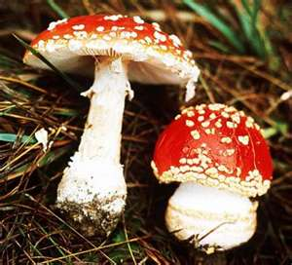
Club Fungi
Produce club shaped reproductive parts in fruiting bodies.
Includes mushrooms, puff balls, rusts, smuts and bracket fungi

Slide 11
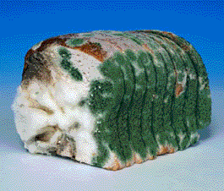
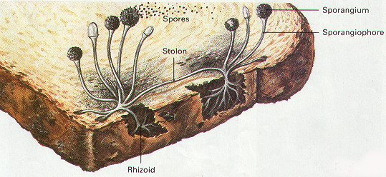
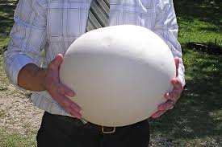
Zygospore Fungi
Also called case-like fungi
Includes bread moulds
Puff balls

Slide 12
Planet Wild - Fungi

Slide 13
What now?
Read pages 136 -139 and answer the following
In what major ways are fungi different from plants?
What does the term saprophyte mean?
What are the 2 methods of reproduction that fungi can use?
What are spores and where are they made?
Draw and label diagram b) of figure 5 on page 138.
Name and describe 2 fungal diseases that affect humans
List 2 benefits for humans provided by mushrooms.

