Slide 1
Circulatory System

Slide 2
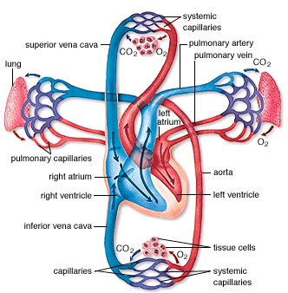
The Circulatory System
Function
Transports oxygen (O₂) and nutrients throughout the body
Carries away carbon dioxide (CO₂) and wastes
Maintains body temperature
Circulation of hormones

Slide 3
The Circulatory System
Structure
It is made up of 3 components
Transport vessels
Transport medium
Pumping Mechanism (heart!)

Slide 4
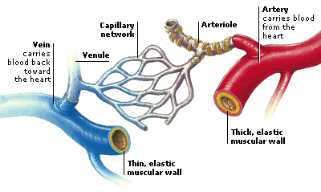
1. Transport Vessels
A network of tubes that carry blood
Contains 3 types of vessels
a) Arteries b) Veins c) Capillaries

Slide 5
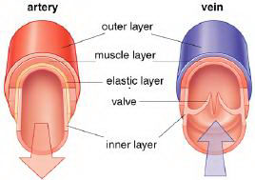
The Artery
Arteries:
Carry blood away from the heart
Carry oxygen rich blood
Thick, muscular walls
which expand due to
tremendous pressure
As muscles contracts it
pushes blood forward

Slide 6
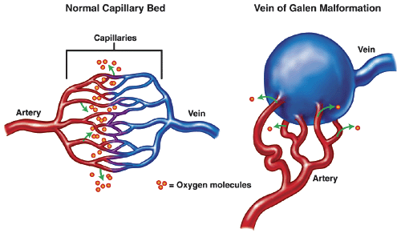
The Capillary
Capillaries
Connect arteries to veins
Only 1 cell thick to allow maximum gas and nutrient exchange through transport cell membranes

Slide 7
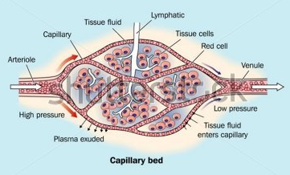
The Capillary
A collection of capillaries is known as a capillary bed

Slide 8
The Vein
Carry blood back to the heart
Carry deoxygenated blood
Have thin walls but a larger inner circumference so they can hold more blood than an artery
Movement of blood is caused
by contraction of nearby
muscles in the body
Valves prevent backward
flow of blood

Slide 9
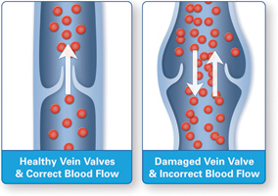
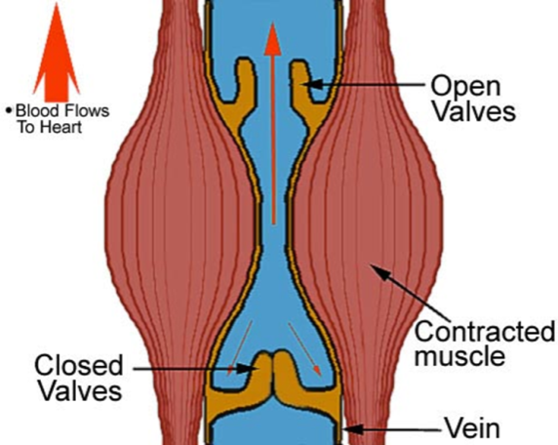
The Vein

Slide 10
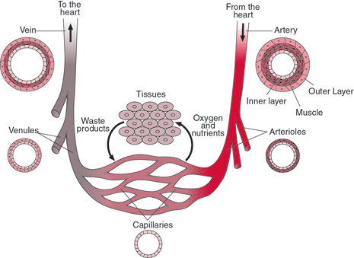

Slide 11
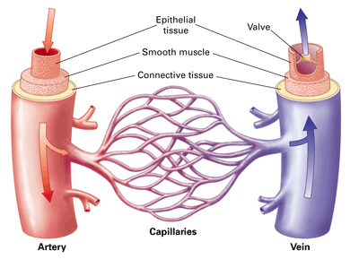

Slide 12
2. Transport Medium
Nutrients
Red Blood Cells
White Blood Cells
Blood
Oxygen
Waste
Carbon Dioxide
Plateletes
Plasma
Hormones

Slide 13
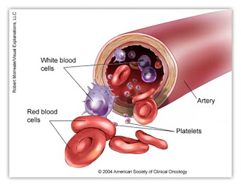
Blood
A connective tissue circulating through the body “connecting” all parts
It contains 4 parts:
Red blood cells
White blood cells
Platelets
plasma

Slide 14
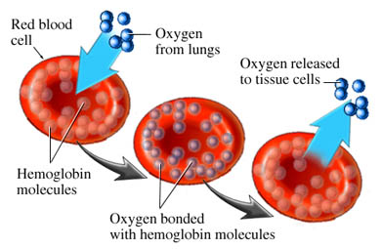
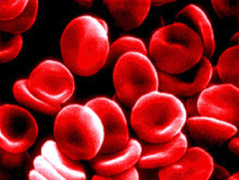
Red Blood Cells
Contains hemoglobin, which transports O₂ to organs and CO₂ away from organs
Human RBC’s have no nucleus to allow more room for hemoglobin (about 280 million/cell!!)
Males: 5.5 million/ml Females: 4.5 million/ml

Slide 15
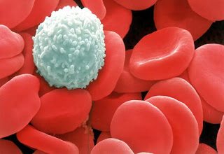
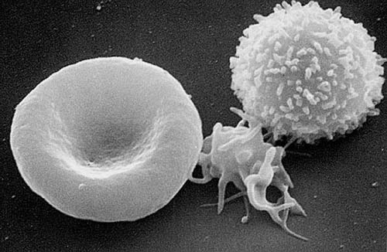
White Blood Cells
Make up 1% of blood
Fight infection from foreign microorganisms
2 Main Types of WBC
Some engulf microorganisms and use enzymes to digest them
Some produce antibodies that are specialized to attack and kill a specific type of invader

Slide 16
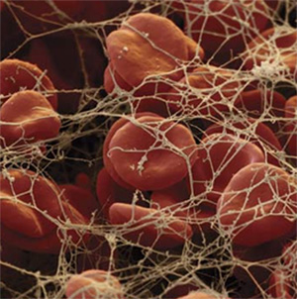
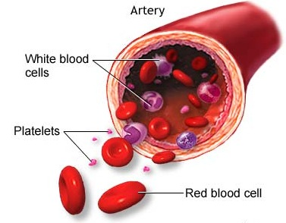
Platelets
Are not cells but fragments of cells created by the bone marrow
No nucleus
Play an important role in clotting blood

Slide 17
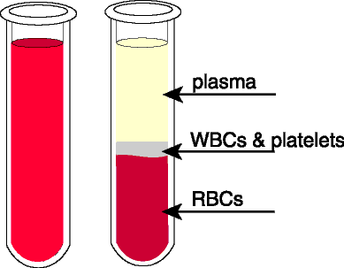
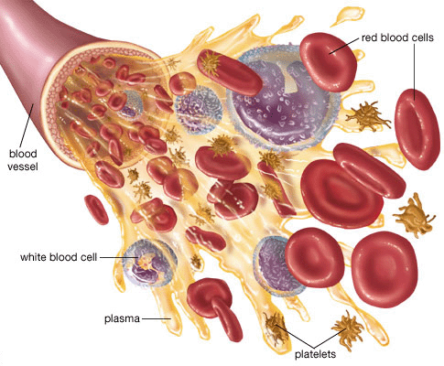
Plasma
Liquid which carries blood components (water, oxygen, carbon dioxide, vitamins, minerals, sugar, proteins, waste)
Critical in helping to maintain homeostasis of water levels
92% is water

Slide 18
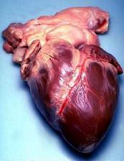
3. Pumping Mechanism: The Heart
The heart is the pumping mechanism for the circulatory system
Pushes blood through the system with each contraction
Heart beat is controlled by a pacemaker
Heart rate is affect by exercise,
emotions, chemicals
- depends on oxygen/carbon dioxide
levels (homeostasis)

Slide 19
Pathway of Blood Around the Body
The body is made up of 2 circulation loops
Pulmonary system (lungs)
Systemic system (body)
Video

Slide 20
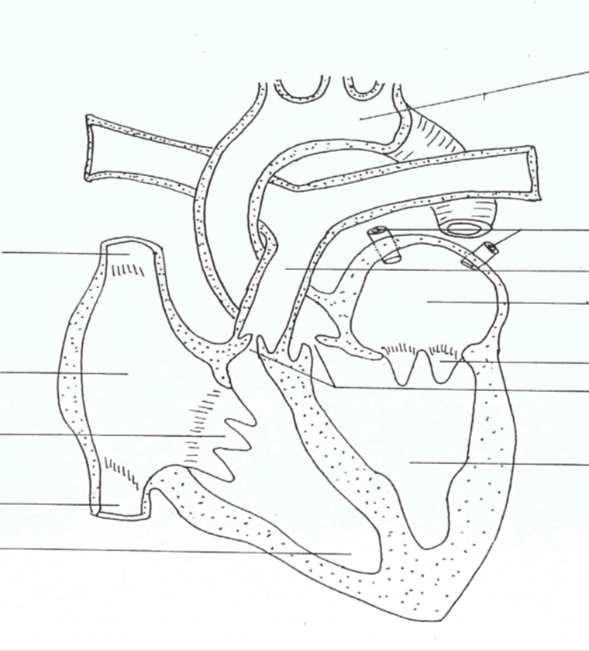
The Human Heart
Human Heart
Aorta
Pulmonary Veins
Superior vena cava
Pulmonary Artery
Left Atrium
Right Atrium
Bicuspid Valve
Tricuspid Valve
Semilunar Valves
Left Ventricle
Inferior Vena Cava
Septum
Right Ventricle

Slide 22
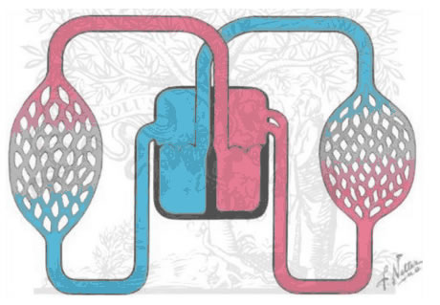
Deoxygenated blood (lots of CO₂)
Oxygen rich blood
Pulmonary Vein
Vena Cava
Right Ventricle
Left Ventricle
Capillaries exchanging gases in lungs with alveolus
Capillaries of Body
Right Atrium
Left Atrium
Pulmonary Artery
Arteries

Slide 23
What do I do now?
Text page 269 - 275 #5-14
Make flash cards
Draw your own picture of the circulatory system and the heart

